Slide 1
SWEN90016 Software Processes & Project Management
Configuration
and
Version Control
2018 – Semester 2
Tutorial 10
Copyright University of Melbourne 2017

Slide 2
Today’s aim
Become familiar with
GIT
and octocat ….
Then the worksheet activities

Slide 3
So what is Git?
Version Control System
Made by Linus Torvalds!
who, what, where, when of code
famous guru - transformed technology twice
Created kernel for Linux OSs , Android and Chrome OS
Created Git, the source code management system
meet Tux, slightly overweight penguin
Notes:
a mature software development environment has the following processes:
- code sharing
- code backup
- roll-back
- parallel branching
ted.com/talks/linus_torvalds_the_mind_behind_linux

Slide 4
So what is Git?
From Lecture 10, slide 14
WHAT: identify artefacts under versioning control
WHERE: items stored in REPO: version control repository
WHO: tags items with your name (collection remains consistent)
WHEN: tags item with date (versions exist)
WHY: quality code sharing, back up, roll-back, parallel branching
The “why” is recorded by your comment on the commit!
Notes:
a mature software development environment has the following processes:
- code sharing
- code backup
- roll-back
- parallel branching

Slide 5
Git Advantages
Distributed (everyone has their own code repository local to them!)
Open Source (everyone likes open source code 😀)
Bomb proof
Notes:
Distributed is fast, no network bottle necks
Distributed is bomb proof
http://thehackernews.com/2015/03/github-hit-by-massive-ddos-attack-from_27.html
attack specifically targets two popular Github projects – GreatFire and CN-NYTimes – anti-censorship tools used to help Chinese citizens circumvent The Great Firewall Of China, the government's censorship of Internet access in China.
Open sourced code evolves quickly

Slide 6
General Git Workflow
git init
git add filename
git commit -m “message”
git push
Initialize local repository called master
Track changes made to the contents of this file
Save this file in local repository
Save this collection
- to remote repository called origin
- from local repository called master
Notes:
Initially use the KISS principle: Keep It Simple Stupid

Slide 7
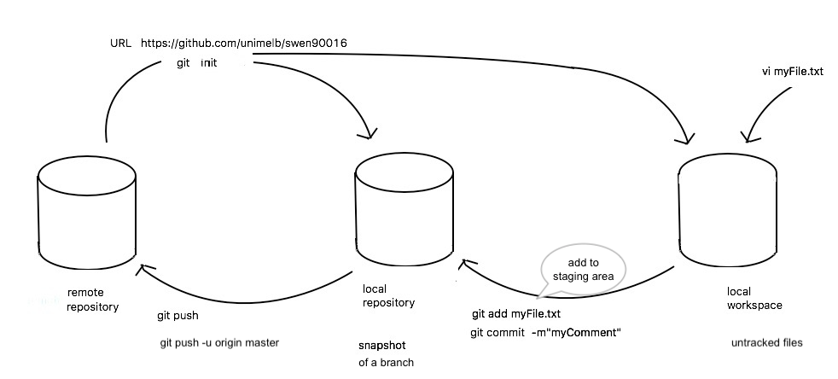
git Round Trip
my file
init
origin
master
push
add, commit
Notes:
Simple visual round trip when you run
The “origin” name is not special, it is the default name for a remote REPO when you run git clone.
The branch name “master” is not special. While “master” is the default name for a starting branch when you run git init,
If you run git clone -o booyah instead, then you will have booyah/master as your default remote branch.
A remote URL is Git's fancy way of saying "the place where your code is stored."

Slide 8
git remote repository
Set the remote repository, using whatever URL
git remote add origin https://bitbucket.org/SWEN90016_2019s1/swen90016_2019s1/src/master/
Publish your commits from your local master repository to shared remote origin for other people, eventually
The label remote is where your shared code is stored
Notes:
A remote URL is Git's fancy way of saying "the place where your code is stored."
git-remote - manage set of tracked repositories ("remotes") whose branches you track.
git remote add [-t <branch>] [-m <master>] [-f] [--[no-]tags] [--mirror=<fetch|push>] <name> <url>

Slide 9
git clone
What it does:
Initializes an empty local repository
fetches code from remote repository into your local repository
its not empty!
Alternative:
git pull remote_repository_URL
What it does: fetches code from the remote repository into your local repository,
Notes:
Shortcut, used often.
Don’t need to do “git pull”, as git clone does it under the hood
get the whole copy, a lot of history, and it can take a while

Slide 10
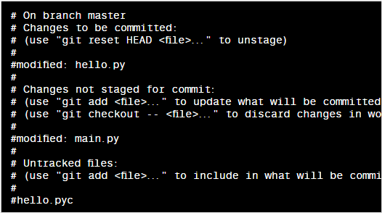
git status
What it does: Shows you the status of your local repository
shows files to be added, modified and untracked files as well.
Example command:
git status

Slide 11
git: Add / Remove
Adds or removes a file from your workspace to your local repository
Files in local repository are called “staged”
Staged files have their contents monitored
Example command:
git add filename or git rm filename

Slide 12
git commit
What it does: This saves your changes to the local repository.
Example command:
git commit -m “some message!”
Notes:
Safety of code form accidental deletion
Can roll back from here.

Slide 13
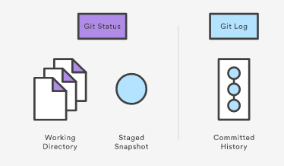
git log
What does it do: Shows the history of commits into the system.
Example command:
git log
Notes:
Do this before push to remote repo

Slide 14
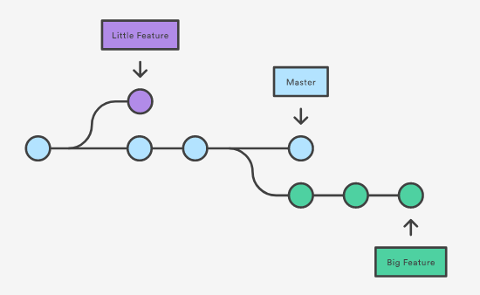
git concept: branching
Notes:
Parallel development

Slide 15
Notes:
http://nvie.com/posts/a-successful-git-branching-model/
Discuss the following git development configuration. Identify where the hotfix get merged into the master branch and the develop branch.

Slide 16
git on the UniMelb server
From lab computer, run Command Prompt, then any SSH client
(PuTTY/ MobaXterm/ Terminal/ Bitvise,)
ssh into Uni server dimefox2.eng.unimelb.edu.au
Login: ssh <your LMSUsername>@dimefox2.eng.unimelb.edu.au>
You now have access ☺
- Go to LMS and follow the tutorial exercises
Notes:
Log in to room computers:
unimelb\eocallaghan
password
Start ssh client
Start Button click -> “Putty” -> “starting …” -> PuTTy Configuration.
PuTTy Configuration options:
dimefox2.eng.unimelb.edu.au
22
SSH
“open”
trust ? = yes
Log in to git server
eocallaghan
password
Create a file
start vim editor
vim “someFile”
switch to text insertion mode
press ‘i’
type some content into file
and after you are done, press Esc. then type :wq and hit enter.

Slide 17
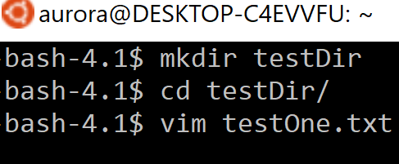
git on the UniMelb server
Type these unix and git commands:
1. mkdir testDir
2. cd testDir
3. git init
4. vim testOne.txt
create a local git repository in testDir
create a file, and save it, then exit
Check testOne.txt exists:
ls LL (LL CAPITALISED)
to show the directory contents with the testOne.txt file
Notes:
Log in to room computers:
unimelb\eocallaghan
password
Start ssh client
Start Button click -> “Putty” -> “starting …” -> PuTTy Configuration.
PuTTy Configuration options:
dimefox2.eng.unimelb.edu.au
22
SSH
“open”
trust ? = yes
Log in to git server
eocallaghan
password
Create a file
start vim editor
vim “someFile”
switch to text insertion mode
press ‘i’
type some content into file
and after you are done, press Esc. then type :wq and hit enter.

Slide 18
git on the UniMelb server
5. git status
6. git add .
git status
7. git commit –m “I commit this file”
git status
8. git log
Check file’s git status
untracked file: testOne.txt
This file has not been “staged”, the contents are not tracked yet.
file has been staged
file has been checked in
Notes:
Type some content into the vim editor using insertion mode (press ‘i’) and after you are done, press Esc. Then type :wq and hit enter.

Slide 19
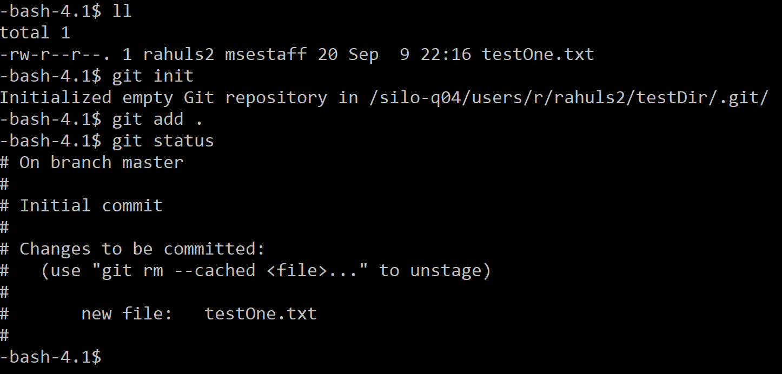
git on the UniMelb server
9. vim testOne.txt
10. git status
11. git commit –m “second commit”
12. git status
13. git log
14. git rm testOne.txt
update file, and save it, then exit
check file’s git status
Notes:
git on the UniMelb server

Slide 20
Done!
References:
https://www.atlassian.com/git/tutorials
https://git-scm.com/
http://thehackernews.com/2015/03/github-hit-by-massive-ddos-attack from_27.html

